Slide 1

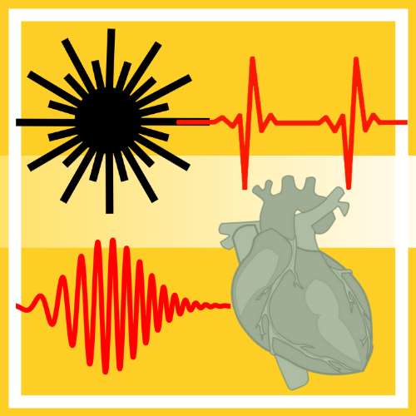
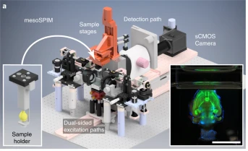
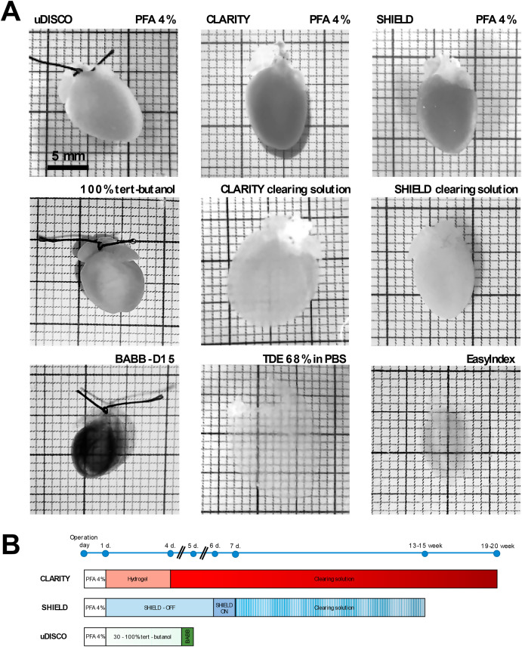
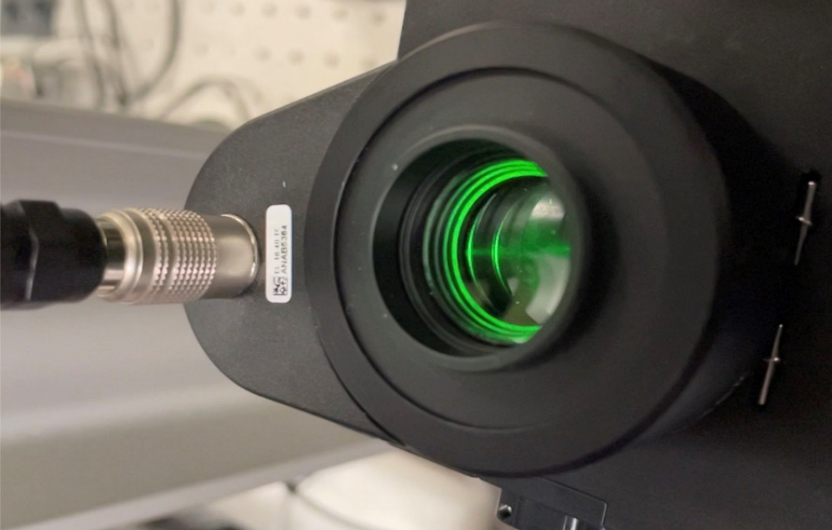
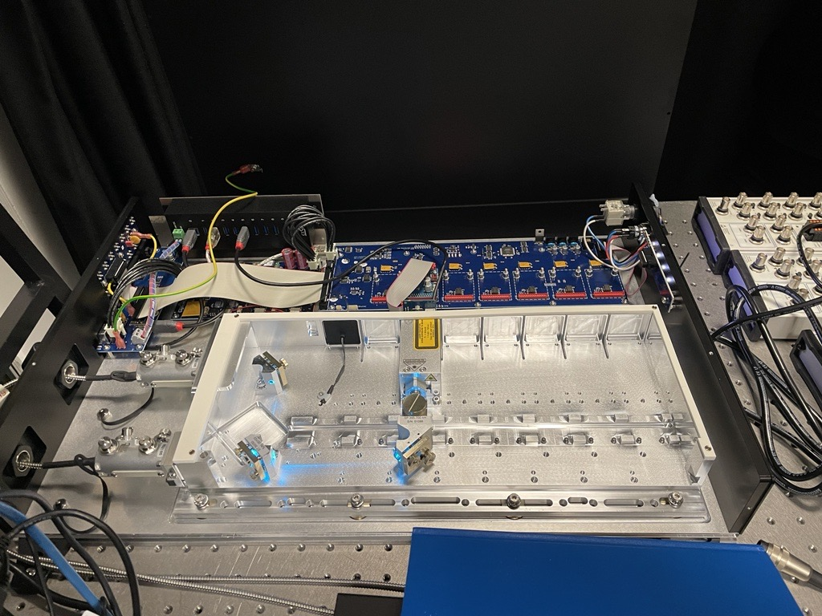
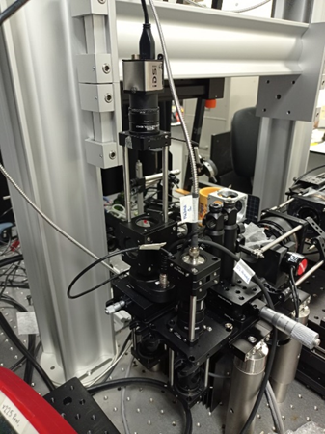
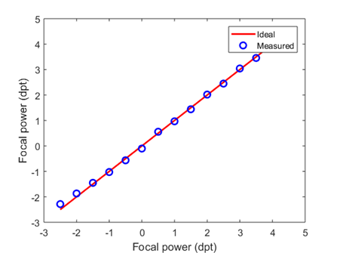
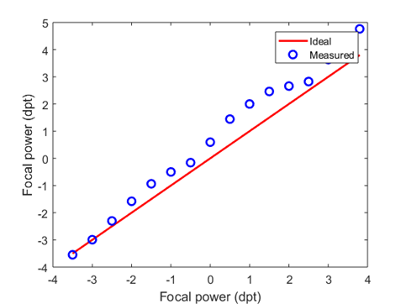
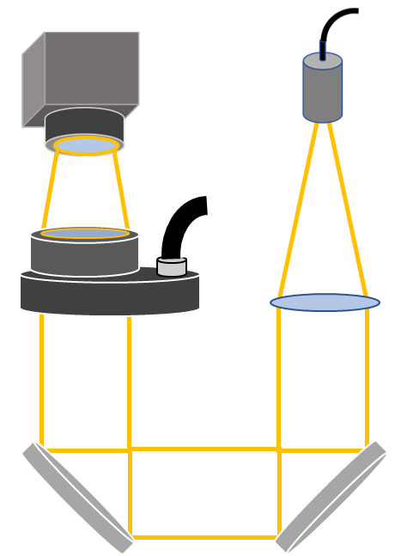
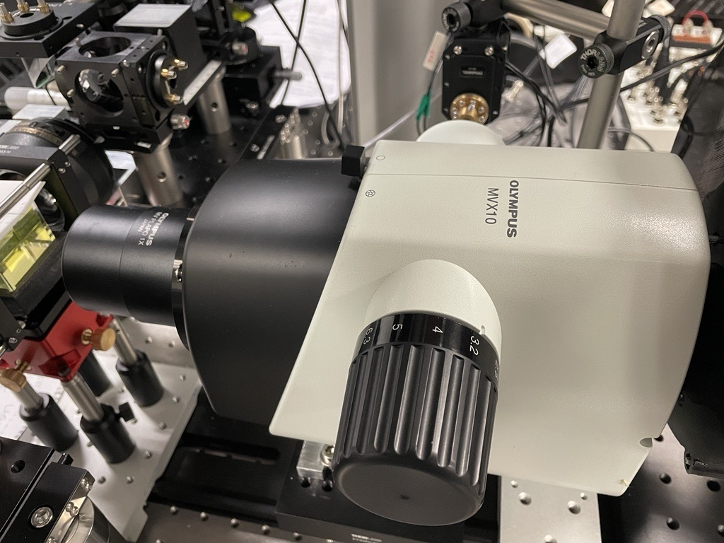
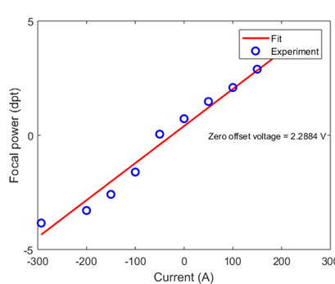
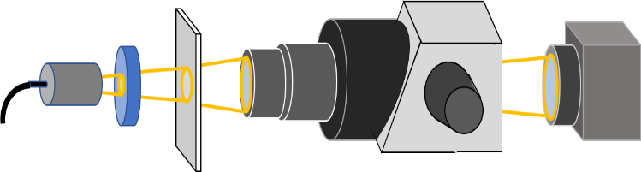
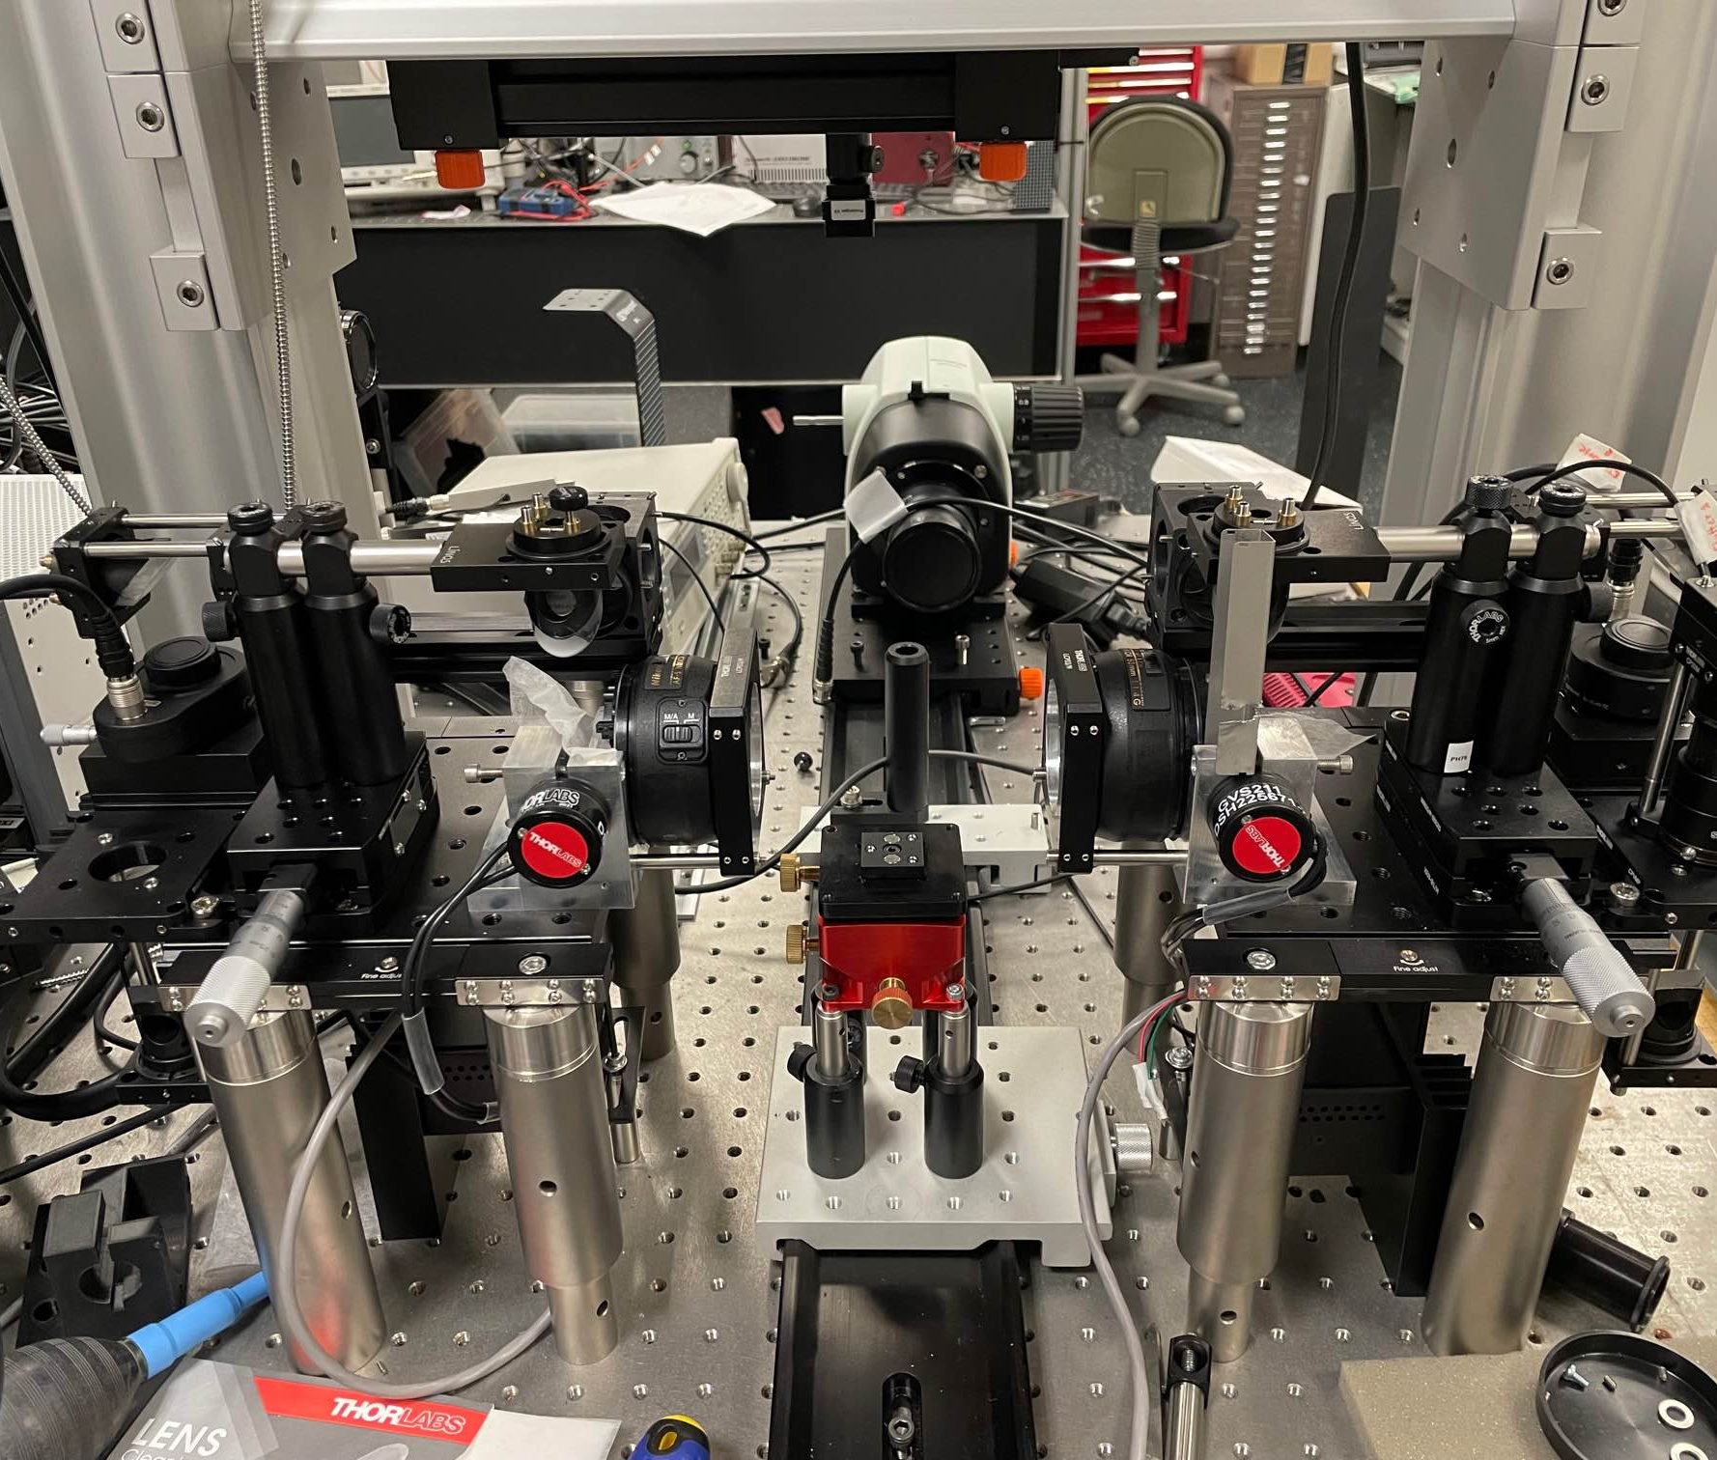
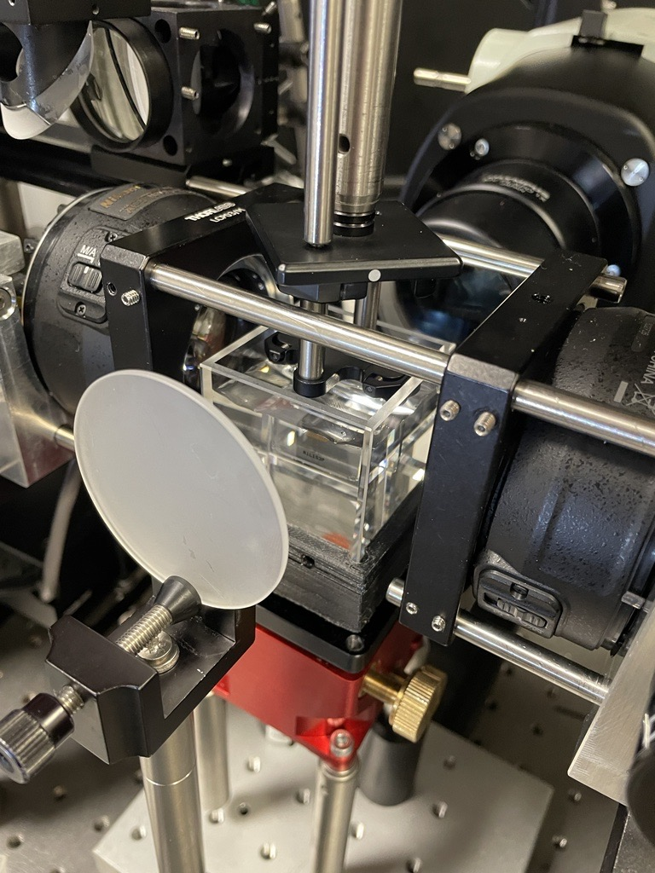
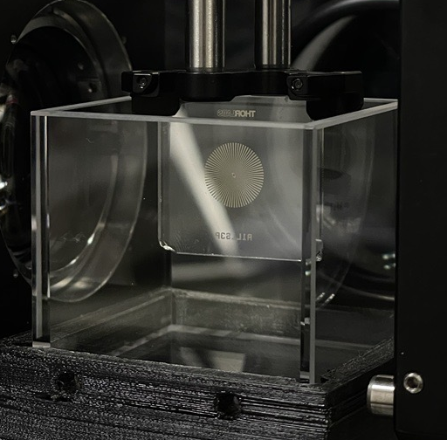


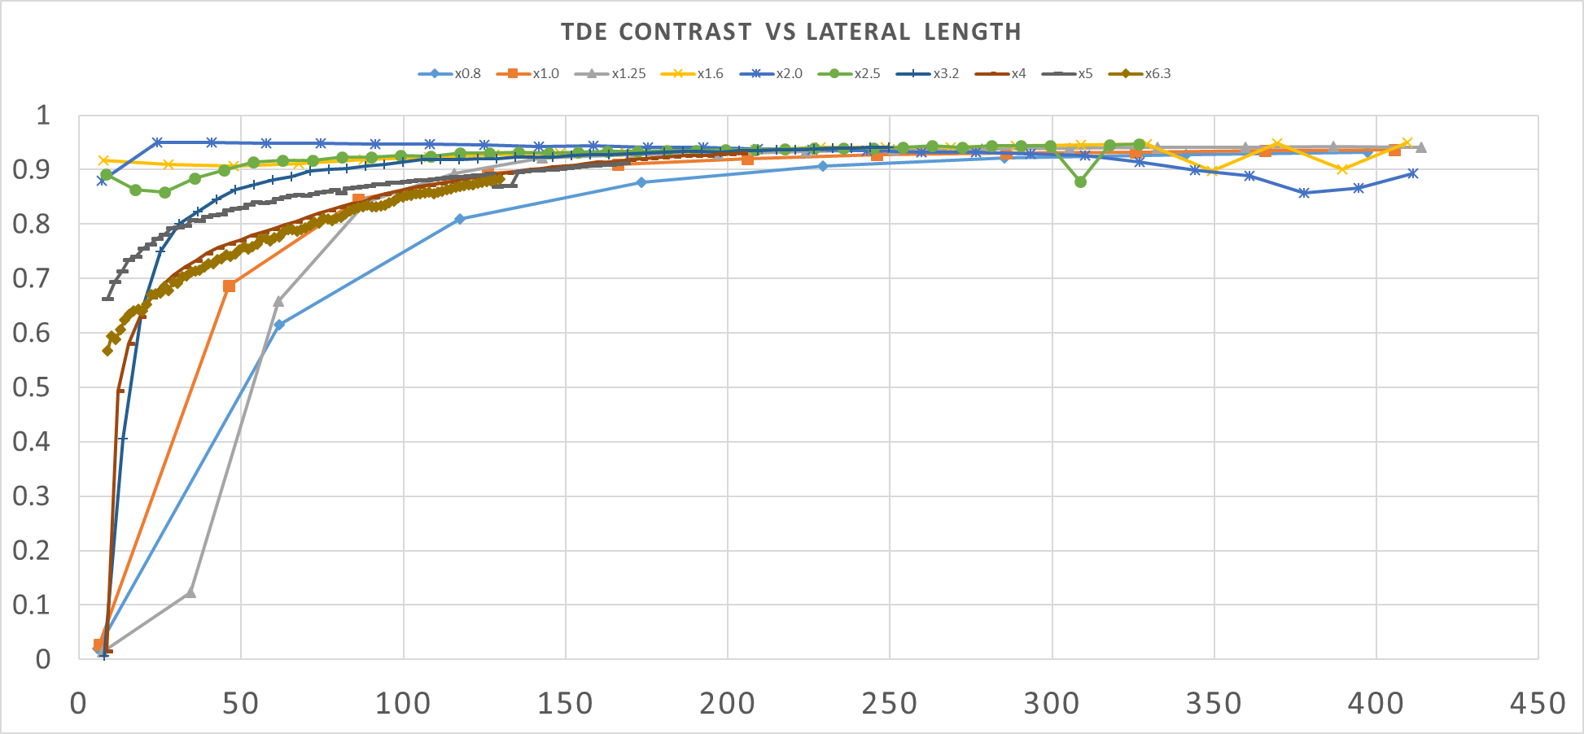
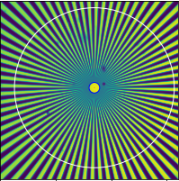


Characterization and Alignment of mesoSPIM Light Sheet Microscope Components
Steven Milan Moreno¹, Sharika Mohanan¹, Will McNeill¹, Andrew Allan², Godfrey Smith³ and Caroline Müllenbroich¹
¹ School of Physics and Astronomy, University of Glasgow, UK
² Cairn Research, Ltd., Kent, England, UK
³ Institute of Cardiovascular and Medical Sciences, University of Glasgow, Glasgow, UK
Background
Light Sheet Microscopy for Cardiac Imaging in Health and Disease
Figure 1:
a) mesoSPIM v7 setup [2]
b-c) CLARITY cleared murine heart sample before (a) and after (b) clearing protocol [1]
Structural imaging of cardiac tissue can be achieved utilizing light sheet microscopy techniques on tissue cleared heart samples [1].
mesoSPIM Microscopy utilizes axially swept focus, dual sided excitation (left and right), and rolling camera shutter to achieve high, isotropic resolution across an readable volume of 44mm x 44mm x 100mm (~194 cm³) [2].
Magnification system allows higher resolution imaging in smaller field of views than was previously achieved in mesoSPIM setups.
1a)
1b)
1c)
System Alignment
Electronically Tunable Lens (ETL)
*See poster P6 for the details on the alignment of the laser excitation and camera detection arms of the mesoSPIM system
LightHUB ULTRA Laser Alignment*
Alignment Attempt | Initial Line Output (mW) | Fibre 1 Power Output (mW) | Fibre 2 Power Output (mW)
1 | 0.32 | 0.25 | 0.07
2 | 56.4 | 29.3 | 27.1
3 | 66.1 | 32.6 | 33.5
Optotune EL-16-40-TC-VIS-5D-C ETLs (x2, Left and Right)
Features:
Installed Laser Lines: 1 (6 max)
Laser Line Wavelength: 488nm
Max Power: 100mW
Fiber Lines: 2, 50/50 Split
Installed fibre switch creates dual emission channels
Even power split obtained for optimal light sheet formation
Features:
Focal Length Range: -500mm to 333mm
Current Range: -500 mA to 500 mA
Control Mechanism: PC via Optotune Lens Driver 4i
^{Optotune ETLs were} characterised using digital inputs from their proprietary software to check for offset and/or drift
ETL permits user control by setting focal power for each lens directly or by setting current sent to each lens.
Focal Power control using Current setting required zero offset of voltage (2.2884V for right side ETL, 1.9394V for left side ETL)
Figure 2:
a) Internal View of laser pathway, beam path marked with yellow arrows
b) Chart displaying balancing of laser power during laser alignment process
4a)
IDS Camera
Laser Fibre Collimator
4c)
4d)
Focal Power Measured (dpt)
Focal Power Measured (dpt)
Zoom Body
ETL
ETL 1
ETL 2
Olympus MVX-10 Zoom Body + MVPLAP01x Objective
Focal Power Setting (dpt)
Focal Power Setting (dpt)
Features:
Magnification Range: x0.8-x6.3
Objective Numerical Aperture: 0.25
Objective Magnification: x1.0
Control Mechanism: PC via servo
Lens Tube,
f = 75mm
4e)
4f)
Focal Power Measured (dpt)
Focal Power Measured (dpt)
ETL 2
Mirrors (45º Tilt)
ETL 1
4b)
Current (A)
Current (A)
Siemens Star target suspended in cuvette filled with 68% TDE solution
LED light and diffuser positioned to capture pixel data without saturation.
Teledyne Photometrics Kinetix sCMOS Camera used to capture 16-bit images with 6.5µm x 6.5µm pixel size
Imaging data recorded for all listed magnification settings available for zoom body.
Figure 4:
a) Image of experimental setup
b) Diagram of experimental setup and components.
c-d) Plots of focal power recorded for left (c) and right (d) ETL focal power settings.
e-f) Plots of focal power recorded for left (e) and right (f) ETL current settings.
3a)
Cuvette
TDE/H₂O Solution
Olympus x1 Objective
Lens Tubing
Teledyne Kinetix Camera
Outlook
LED
Light
Our assembled light sheet imaging system will be applied for structural imaging of cleared mouse and rabbit hearts.
Diffuser
Siemen Star Target
Olympus Zoom Body
Tube Lens, f = 180mm
Aim is to have a deeper understanding of cardiac structure through use of imaging system in association with tissue clearing protocols.
Figure 3:
a) Diagram of experimental set up and components.
b-c) Images of experiment setup.
d) Plot of contrast vs lateral distances for x0.8 – x6.3 magnification settings with TDE solution medium.
e) 16-bit image of Siemen star target obtained for use in calculation of contrast transfer function (CTF)
3b)
3c)
Acknowledgments
3d)
3e)
3e)
Contrast Transfer Function
References
[1] Giardini, et al. Journal of Visualized Experiments 176 (2021): 62795.
[2] Voight, et al. Natural Methods 16.11 (2019): 1105-8.
[3] Dean, et al. Nature Protocols 17.9 (2022): 2025-2053.
Lateral Distance Examined [µm]

